Slide 1
APA 7th Edition
Wor-Wic Community College Library Services

Slide 2

Please refer to the APA Publication Manual 7th Edition or the APA Blog
https://apastyle.apa.org/blog
(APA, 2020)

Slide 3
APA 7th Edition Formatting
APA uses the author date system.
For student papers:
  Running head is not required.
  Abstract is not required.
  Variety of fonts accepted but font needs to be the same throughout paper.
  Bias free language—see Chapter 5 in APA 7th Ed. Manual.
  One space after a period.
  Highlight words with quotations not italics.
  Headings are in bold.
(APA, 2020 & Purdue Owl, 2019)

Slide 4
APA 7th Edition Changes
Publisher location is not included.
  Stoneman, R. (2008). Alexander the Great: A life in legend. Yale University Press.
In-text citation sources with 3 or more authors are shortened to first author’s name followed by “et al.” (Smith et al., 2020).
Up to 20 authors instead of 7 are included for each source in Reference List.
  Pegion, K., Kirtman, B. P., Becker, E., Collins, D. C., LaJoie, E., Burgman, R., Bell, R., DelSole, R., Min, D., Zhu, Y., Li, W., Sinsky, E., Guan, H., Gottschalck, J., Metzger, E. J., Barton, N. P., Achuthavarier, D., Marshak, J., Koster, R., . . . Kim, H. (2019). The subseasonal experiment (SubX): A multimodel subseasonal prediction experiment. Bulletin of the American Meteorological Society, 100(10), 2043-2061. https://doi.org/10.1175/BAMS-D-18-0270.1
DOIs are formatted the same as URLs
  Drollinger, T., Comer, L. B., & Warrington, P. T. (2006). Development and validation of the active empathetic listening scale. Psychology & Marketing, 23(2), 161-180. https://doi.org/10.1002/mar.20105
Do not include “Retrieved from” before a URL on Reference List
  Price, D. (2018, March 23). Laziness does not exist. Medium. https://humanparts.medium.com/laziness-does-not-exist-3af27e312d01
No running head on title page.
One space between sentences.
References title heading on reference list is in bold.
(APA, 2020 & Purdue Owl, 2019)

Slide 5
APA 7th Edition
Title Page
If no directions by Instructor, use APA 7th Edition title page:
Title of the paper
Name of author of the paper
Name of school
Course number and name (e.g., OTA 101)
Course instructor’s name and title
Assignment’s due date
A page number (which also appears on the following pages)
(APA, 2020 & Purdue Owl, 2019)

Slide 6
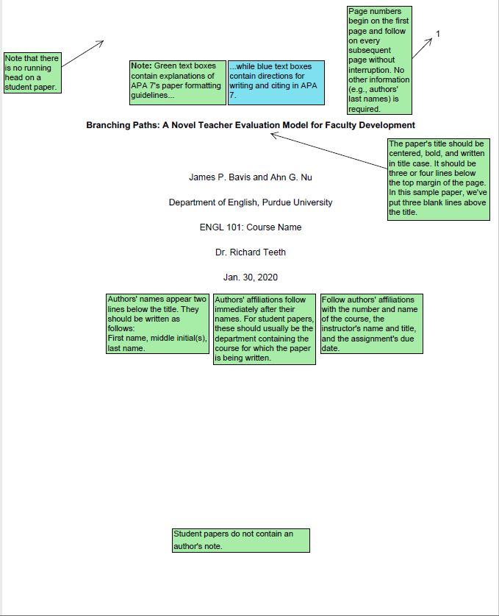
APA 7th Edition Title Page Example
(Purdue Owl, 2019)

Slide 7
APA 7th Edition In-Text Citations
Cite all sources with three authors or more by using the name of the first author followed by “et al.” (Smith et al., 2020).
“Use quotations around exact quotes followed by (author, year, page number) in parenthesis” (Smith, 2016, p. 303).
When paraphrasing, include author, year, and if available, page or paragraph number in parenthesis (Smith, 2016) or (Smith, 2016, p. 33-45).
For no page numbers, use paragraph number and section heading (Smith, 2016, Treatment section, para. 3).
For unknown author, use quotes around first word in title of article followed by date in parenthesis (“Changes,” 2016).
(APA, 2020)

Slide 8
APA Reference List
“References” title is now in bold.
Sources are in alphabetical order in the Reference list
Spell out author’s last name & use initials for first name (Smith, D.T.)
Article title is in lower case: Satisfaction levels with physical therapy in hospitalized patients.
Italicize journal title and volume number—Journal of Occupational Therapy, 45(3), 20-32.
Do not italicize the issue number—45(3)
Give the journal’s homepage URL, when there is no DOI—
https://ajot.aota.org/index.aspx
Include a direct URL for website sources—
https://www.ncbi.nlm.nih.gov/pubmed/22243475 (APA, 2020 & Purdue Owl, 2019)

Slide 9
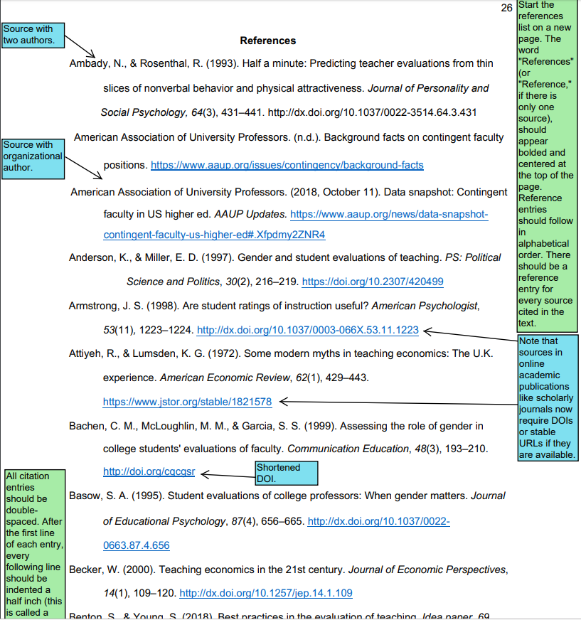
Purdue Owl’s APA 7th Edition Reference List
(Purdue Owl, 2019)

Slide 10
Which citation has the correct APA format?
A, B, or C?
References
A. Atwal, A., Spiliotopoulou, G., Stradden, J., Fellows, V., Anako, E., Robinson, L., & McIntyre, A.
(2014). Factors influencing occupational therapy home visit practice: A qualitative
study. Scandinavian Journal Of Occupational Therapy, 21(1), 40-47.
https://doi.org/10.3109/11038128.2013.821162
B. Atwal, A., Spiliotopoulou, G., Stradden, J., Fellows, V., Anako, E., Robinson, L., & McIntyre, A. (2014). Factors influencing occupational therapy home visit practice: A qualitative study. Scandinavian Journal Of Occupational Therapy, 21(1), 40-47.
C. Atwal, A., Spiliotopoulou, G., Stradden, J., Fellows, V., Anako, E., Robinson, L., & McIntyre, A. (2014). Factors Influencing Occupational Therapy Home Visit Practice: A Qualitative Study. Scandinavian Journal Of Occupational Therapy, 21(1), 40-47. Retrieved from EBSCOhost.
Notes:
Take a look at these citations for a Reference page. It’s the same source for all three letters A, B, or C but which citation has the correct APA format when an empirical study article from a scholarly journal is found in a subscription database? Which letter is correct A., B., or C.? The answer is A—the title is in sentence format—capitalize only the first word or any proper nouns (names of things)—the journal title and the volume number is in italics. There’s a hanging indent and it’s double spaced. And for the retrieval information, first you need the DOI-digital object identifier. If the DOI is not available, APA requires the homepage URL of the journal but supports exceptions like using the name of the database. Letter B. does not include retrieval information which would be the DOI, it’s not double spaced and it doesn’t have a hanging indent. Letter C. is not double spaced with a hanging indent, the title of the article should not be capitalized except for the first word, “Factors” and the first word after the colon “A”, the title of the journal, Scandinavian Journal of Occupational Therapy should be in italics and volume 21 should also be in italics, and the retrieval information is incorrect—it should include the DOI and if that’s not available it should say Retrieved from and the URL of the journal’s homepage or the name of the database not the vendors name—so it would say Retrieved from CINAHL Plus with Full-Text database not Retrieved from EBSCOhost which is the vendors name—the vendor is the company that owns the databases. If you have any questions on APA formatting, please come see me in the library center or ask library staff for help. Thank you.

Slide 11

APA 7th Edition Help
Use Purdue Owl’s APA citation maker and Style Guide at this link:
https://owl.purdue.edu/owl/research_and_citation/apa_style/apa_formatting_and_style_guide/apa_sample_paper.html
Go to Wor-Wic Library’s web page under Citing Sources > APA:
https://www.worwic.edu/Services-Support/Academic-Support/Resource-Centers-(Library)

Slide 12
References
American Psychological Association. (2020). Publication manual of the American Psychological Association (7th ed.). http://www.apa.org/pubs/books/images/4200066-475.gif
Myers, M., Paiz, J., Angeli, E., Wagner, J., Lawrick, E., Moore, K., Anderson, M.,…Keck, R. (2019, December 20). General format. Purdue Online Writing Lab. https://owl.purdue.edu/owl/research_and_citation/apa_style/apa_formatting_and_style_guide/general_format.html

